Slide 1
Improving Upon Meta-learning Algorithms
Collin Avidano
Michael Munje

Slide 2
Overview
Our idea: Improve upon single Meta RL Algorithm (RL²), with an algorithmic improvement to improve benchmark score on Meta World
We will cover meta-learning, manipulation, meta world, and give a proposed timeline for the project.

Slide 3

Meta-learning
Refers to the class of machine learning algorithms whose intent is to “learn to learn”
We want to minimize the expected loss over multiple datasets (tasks)
1 sample = 1 dataset
Finn, Chelsea, Pieter Abbeel, and Sergey Levine. "Model-agnostic meta-learning for fast adaptation of deep networks." International Conference on Machine Learning. PMLR, 2017.
Notes:
Finish by ~0:30

Slide 4
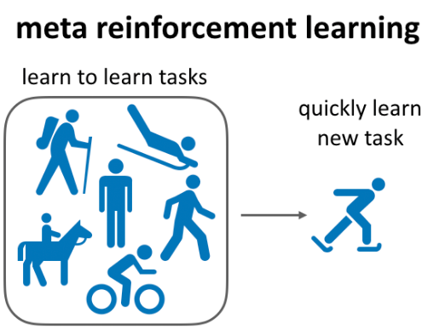
Meta Reinforcement Learning
In Meta RL, we want to be able to quickly learn how to perform new tasks by utilizing the shared structure between the prior set of tasks and the new one
We can think of Meta RL’s tasks as being in a group of MDPs that share the same dynamics but have different reward functions (require different trajectory)
Lin, Zichuan, et al. "Model-based adversarial meta-reinforcement learning." arXiv preprint arXiv:2006.08875 (2020).
Notes:
Finish by ~1:00

Slide 5
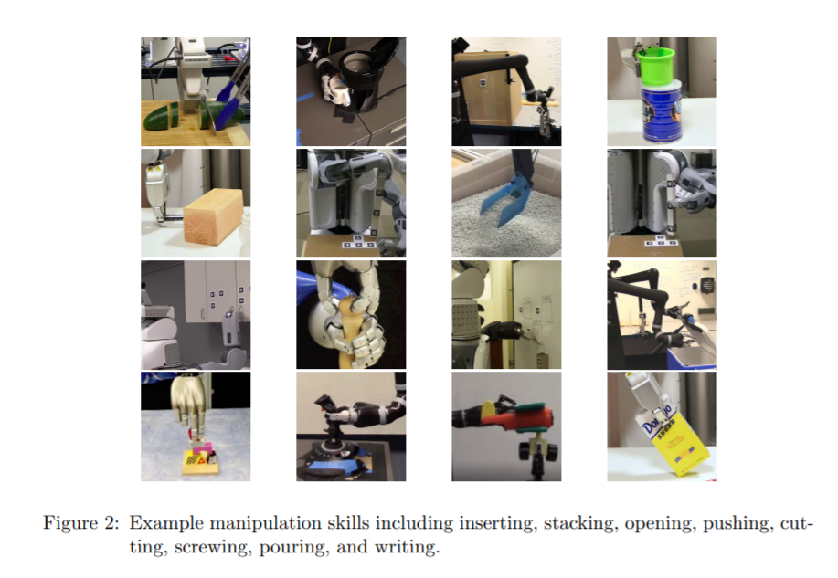
Manipulation
Involves using a robotic arm and end effector to achieve physical tasks that is usually done with human hands
DoF equal to number of joints (in most cases) with a continuous action space
Kroemer, Oliver, Scott Niekum, and George Dimitri Konidaris. "A review of robot learning for manipulation: Challenges, representations, and algorithms." Journal of machine learning research 22.30 (2021).
Notes:
Finish by ~1:30

Slide 6
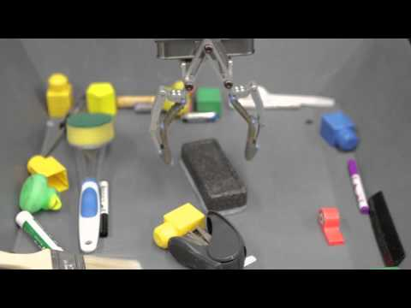
Manipulation Example
Levine, Sergey, et al. "Learning hand-eye coordination for robotic grasping with deep learning and large-scale data collection." The International Journal of Robotics Research 37.4-5 (2018): 421-436.
Notes:
Finish by ~2:30

Slide 7
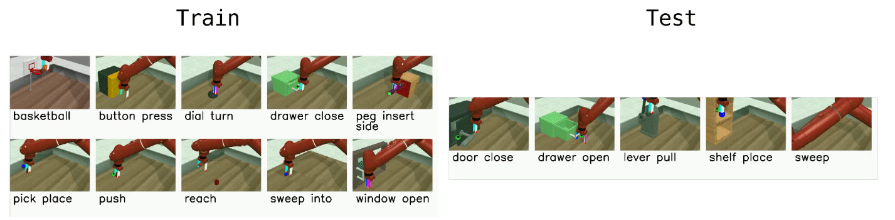
Benchmark: Meta-World
Meta-world is a benchmarking tool for meta-learning algorithms providing benchmarks such as the ML-10 (10 different training tasks) shown below
Yu, Tianhe, et al. "Meta-world: A benchmark and evaluation for multi-task and meta reinforcement learning." Conference on Robot Learning. PMLR, 2020.
Notes:
Finish by ~3:00

Slide 8
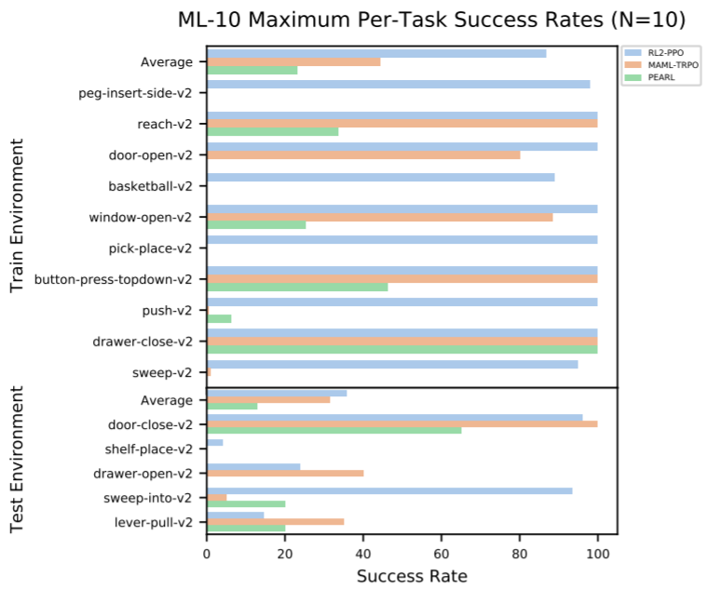
Our Goal
Our primary goal is to develop an agent competitive against the top performing algorithms on Meta-World (MAML, RL², PEARL)
Yu, Tianhe, et al. "Meta-world: A benchmark and evaluation for multi-task and meta reinforcement learning." Conference on Robot Learning. PMLR, 2020.
Notes:
Finish by 3:30

Slide 9
Our Idea
Baseline: Single Meta RL Algorithm (such as RL²), trained with PPO
Alpha: One small improvement such as:
Hierarchical RL or modular meta-learning* being leveraged to aid these algorithms in generalization
OR Strategies to push the representational learning into earlier layers of the network to mitigate the feature reuse**
OR Investigate stable off-policy variants
Contingent on further research
Rakelly, Kate, et al. "Efficient off-policy meta-reinforcement learning via probabilistic context variables." International conference on machine learning. PMLR, 2019.
Duan, Yan, et al. "Rl $^ 2$: Fast reinforcement learning via slow reinforcement learning." arXiv preprint arXiv:1611.02779 (2016).
*Alet, Ferran, Tomás Lozano-Pérez, and Leslie P. Kaelbling. "Modular meta-learning." Conference on Robot Learning. PMLR, 2018.
**Raghu, Aniruddh, et al. "Rapid learning or feature reuse? towards understanding the effectiveness of maml." arXiv preprint arXiv:1909.09157 (2019).

Slide 10
Tentative Timeline
Feb.
March
April
W1
W2
W3
W4
W1
W2
W3
W4
W1
W2
W3
W4
Research into relevant papers
Replicate baseline results with MetaWorld
Get idea of the training time
Try simple alpha and see how it goes
Midterm
Make sure report is up to date
Add solid alpha and check results
Make sure to train early and have data to analyze
Analysis
Final

Slide 11
Questions / Feedback

Slide 12
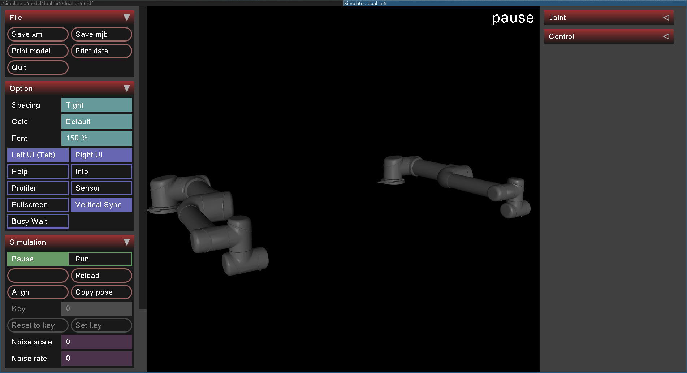
Simulation
MuJoCo will be used as the primary simulation environment to train the agent
Model of UR5 Robotic arm will be used
Todorov, Emanuel et al. “MuJoCo: A physics engine for model-based control.” 2012 IEEE/RSJ International Conference on Intelligent Robots and Systems (2012): 5026-5033.
Notes:
Finish by ~2:30

